Slide 1

Microsoft Azure
Cloud Fundamentals
DATE
1st July 2021

Slide 2
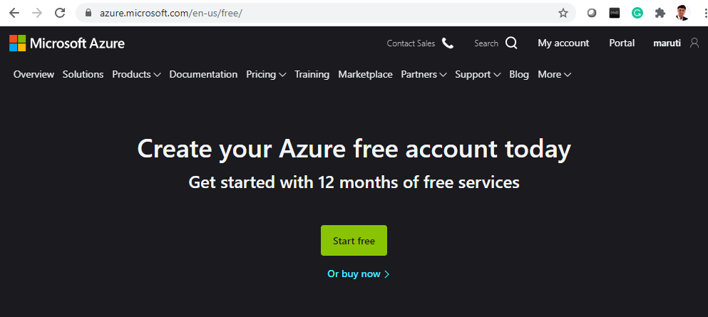
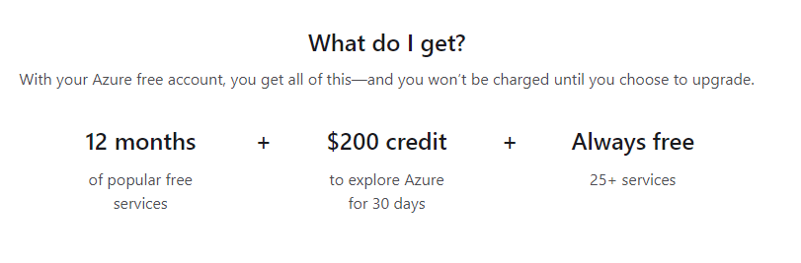
Prerequisites
Get your FREE
Azure Subscription
Today
Notes:
https://azure.microsoft.com/en-us/free/

Slide 3
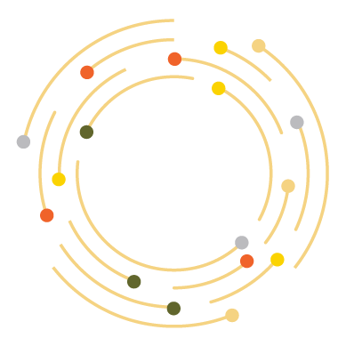


What is Cloud?
AZ-900 Microsoft Azure Fundamentals
An approach to computing that’s about having the right resources at the right time, and connecting to a variety of devices and endpoints.

Slide 4




Why Cloud Computing?
AZ-900 Microsoft Azure Fundamentals
HOME

Slide 5
Why Cloud Computing?
AZ-900 Microsoft Azure Fundamentals
HOME
COST
FLEXIBLE
RISK
ON TIME

Slide 6
Cloud Models
Public cloud:
No capital expenditures to scale up.
Applications can be quickly provisioned and deprovisioned.
Organizations pay only for what they use.
Private cloud:
Organizations have complete control over resources.
Organizations have complete control over security.
Hybrid cloud:
Most flexibility.
Organizations determine where to run their applications.
Organizations control security, compliance, or legal requirements.

Slide 7
IAAS – PAAS - SAAS
AZ-900 Microsoft Azure Fundamentals
On-Premises
( Private Cloud )
Infrastructure
( as a Service )
Platform
( as a Service )
Software
( as a Service )
Data & Access
Data & Access
Data & Access
Data & Access
Applications
Applications
Applications
Applications
You Manage
Runtime
Runtime
Runtime
Runtime
Cloud Provider Manages
Operating System
Operating System
Operating System
Operating System
Virtual Machine
Virtual Machine
Virtual Machine
Virtual Machine
Compute
Compute
Compute
Compute
Networking
Networking
Networking
Networking
Storage
Storage
Storage
Storage

Slide 8
It’s All About Services ! Not About Servers.

Slide 9
Azure Subscription
An Azure subscription provides you with authenticated and authorized access to Azure accounts.
Subscriptions can provide billing and access control boundaries.
An account can have one subscription or multiple subscriptions.

Slide 10
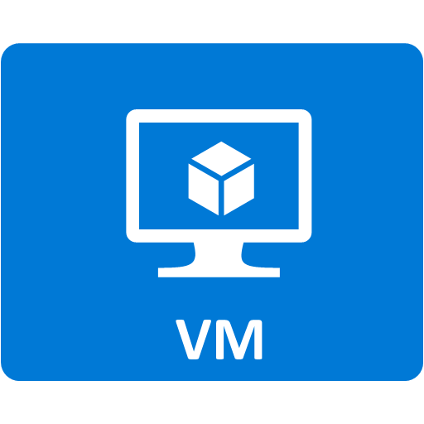


Explore Resource groups
Resource groups (web + DB, VM, Storage) in one group
Containers for multiple resources that share the same life cycle.
OR
Web and DB resource group
Virtual machine resource group
Storage resource group
Notes:
Containers for multiple resources that share the same life cycle.
Aggregates resources into a single manageable unit.
Every Azure resource must exist in one (and only one) resource group.
Secure at the resource group (or resource) level - using role-based access control (RBAC).

Slide 11
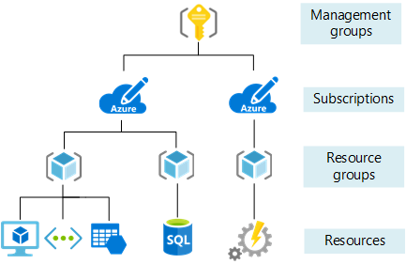
Explore Azure Resource Manager
Provide a management layer that enables you to create, update, delete, and control access to resources in your Azure subscription.
Notes:
You can view more details about Azure Resource Manager at https://docs.microsoft.com/en-us/azure/azure-resource-manager
Provide a management layer that enables you to create, update, and delete resources in your Azure subscription.
Create, configure, manage and delete resources and resource groups.
Organize resources.
Control access and resources.
Automate using different tools and SDKs.

Slide 12
Azure Resource Manager
Azure Service Manager
Azure Resource Manager
Legacy Portal
New Current Portal
No resource groups
Resource groups

Slide 13


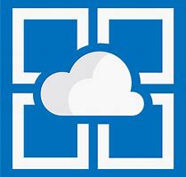

Explore Azure compute services
Azure VMs use Infrastructure as a Service (IaaS) to provide computing power in the cloud.
VM scale sets are designed for automatic scaling of identical VMs.
App services is a Platform as a Service (PaaS) offering to build, deploy, and scale enterprise-grade web, mobile, and API apps.
Functions perform compute actions based on an event.
Notes:
Azure virtual machines - https://azure.microsoft.com/en-us/services/virtual-machines/
Virtual machine scale sets - https://azure.microsoft.com/en-us/services/virtual-machine-scale-sets/
App services - https://azure.microsoft.com/en-us/services/app-service/
Azure Functions - https://azure.microsoft.com/en-us/services/functions/

Slide 14
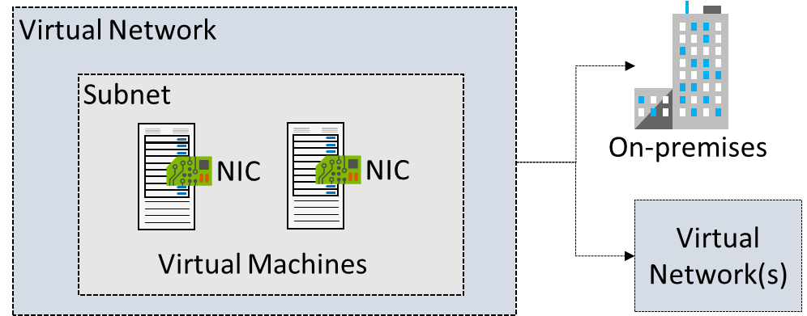
Virtual Network
AZ-900 Microsoft Azure Fundamentals
Logical representation of your own network
MENTOR’S TAG – Make Yourself Future Ready

Slide 15
App Service
Web app, Mobile App and APIs can be developed in multiple languages
Visual studio, DevOps and GIT integrations
Vertical and Horizontal Scaling with Service Plan
Multi Slot rapid deployment
High Availability with Azure Front Door
Connect to Saas platforms and On-premise data
Built in Authentication and Authorization
Serverless and Pass model
Monitoring and App Insight
Integrates local cache
Integrated Web Jobs
.NET
Java
Ruby
Node.JS
PHP
Python

Slide 16
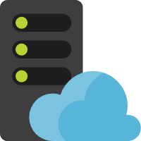

App Service Plan
Web app
App Service plan
Web app
Web app

Slide 17

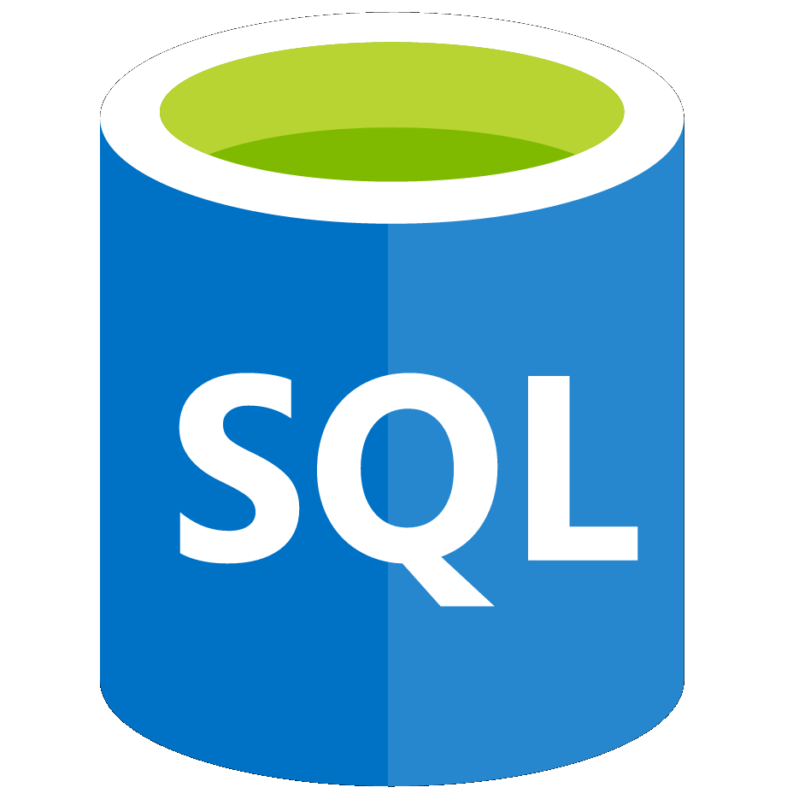
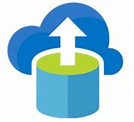
Explore Azure database services
 | Azure Cosmos DB is a globally-distributed database service.
 | Azure SQL Database is a relational database as a service (DaaS).
 | Azure Database Migration is a fully-managed service designed to enable seamless migrations from multiple database sources to.
Notes:
✔️ These are just a few of our database service offerings. Take a minute to review other database services and [find the product you need](https://azure.microsoft.com/en-us/product-categories/databases/).
Azure Cosmos DB is a globally-distributed database service that enables you to elastically and independently scale throughput and storage.
Azure SQL Database is a relational database as a service (DaaS) based on the latest stable version of the Microsoft SQL Server database engine.
Azure Database Migration is a fully-managed service designed to enable seamless migrations from multiple database sources to Azure data platforms with minimal downtime.
Azure Cosmos DB - https://azure.microsoft.com/en-us/services/cosmos-db/
Azure SQL Database - https://azure.microsoft.com/en-us/services/sql-database/
Azure Database Migration Service - https://azure.microsoft.com/en-us/services/database-migration/

